Slide 1

Stock Market Prediction Using Machine Learning Algorithms
Presented by
SOHAN R KUMAR
(1BM19CS159)
Under the guidance of
Ms. Sunayana S
Assistant Professor
Department of Computer Science and Engineering
BMS College and Engineering, Bengaluru

Slide 2


Introduction
1.1 Overview –
Stock market prediction and analysis are some of the most difficult jobs in the world.
Physical & psychological factors, rational & irrational behavior, and so on, combine to make share prices dynamic and volatile and make it extremely hard to anticipate the rise and fall of the market with great precision.
In the current modern age of AI and ML, we are trying to tame this turbulent sea called the stock market and navigate our way through it using Machine Learning algorithms and techniques.

Slide 3


1.2 Motivation –
Analysis and prediction of stock prices is important to enable wise investment choices.
Stock markets help companies to raise capital.
Stock markets serve as an indicator of the state of the economy.
The entire idea of predicting stock prices is to gain significant profits.
1.3 Objectives –
Artificial Intelligence and Machine learning is being used to solve a plethora of problems in the world
The application of Machine Learning for this project is to provide a highly effective, minimal monetary investment, maximum income yielding stocks to invest in.
The main purpose of the prediction is to reduce uncertainty associated to investment decision making.

Slide 4
Literature Survey
Research Paper | Abstract
Forecasting stock market trends using support vector regression and perceptually important points. | Intelligent stock trading systems use soft computing techniques in order to make trading decisions in the stock market.. In order to enable the trading system for trend prediction, this paper suggests using perceptually important points as a turning point prediction framework.
Stock Market Predication Using A Linear Regression | In this paper, by applying linear regression for forecasting behavior of TCS data set, we prove that our proposed method is best to compare the other regression technique method and the stockholders can invest confidentially based on that.
Testing the Application of Support Vector Machine (SVM) to Technical Trading Rules | This paper test the use of a Machine Learning technique known as Support Vector Machines (SVM) aiming at being a tool to support the decision making process of trading at the stock market.

Slide 5
Research Paper | Abstract
Research on Strategy of HS300 Index Based on Random Forest | This paper calculated the 11 technical indicators of the HS300 index, and used the Random Forest model to predict the movements. The results showed that the accuracy of the model calculation to 0.82 and the F-score is 0.84. Then, the daily income of the model was integrated. Then annualized return reached 28.1%, and the maximum drawdown was 0.42, which was significantly higher than the index return.
CUDA parallel computing framework for stock market prediction using K-means clustering | This paper provides the analysis of previous year’s stock market pricing data and interpret results after performing intensive training based on machine learning algorithm on Compute Unified Device Architecture (CUDA) considering the time constraint of real time trading.
Optimization of SV-kNNC using Silhouette Coefficient and LMKNN for Stock Price Prediction | The objective of this research is to propose a model to refine the accuracy of stock prediction and to produce the best class at the data clustering stage.

Slide 6
Research Paper | Abstract
Stock Market Prediction Using Linear Regression and SVM | In this paper, the first task is to use web scrapping to collect datasets from stock data. Then we plot the data on the graph, from the graph we can analyze the stock prices going high or low. After this, we will predict stock prices using SVM and Linear Regression, that Linear Regression for stock market analysis is better than the SVM for the same.
Prediction of Stock Prices using Machine Learning (Regression,Classification) Algorithms | The proposed system works in two methods – Regression and Classification. In regression, the system predicts the closing price of stock of a company, and in classification, the system predicts whether the closing price of stock will increase or decrease the next day
Research and Comparison of Random Forests and Neural Networks in Shanghai and Shenzhen Financial 20 Index Prediction | On the basis of literature and theoretical analysis, the public data sets of a well-known securities firm i s selected to make predictions of the Shanghai and Shenzhen CSI 20 index based on neural networks and random forest models.

Slide 7
Research Paper | Abstract
Research and prediction of Shanghai-Shenzhen 20 Index Based on the Support Vector Machine Model and Gradient Boosting Regression Tree | In order to achieve a more accurate stock index prediction, this paper selects a public data set provided by a well-known securities company to predict the CSI 20 Index (CSI20) based on the gradient-enhancing regression tree model and support vector machine model. RMSE, MAE, and MAPE are selected as the indicators to evaluate the differences in the forecasting ability of the two models in the financial sector. The results of this study can help investors to adopt effective investment strategies and reduce investment risks.
The Public Sentiment analysis within Big data Distributed system for Stock market prediction– A case study on Colombo Stock Exchange | Logistic Regression and Naïve Bayes perform well in sentiment classification. Main finding of this research is that public opinion significantly influences the fluctuations of market forces and economic factors such as monetarism, government reforms, unforeseen pandemics, interest rates, public trust, and faith in bond market trust. The detection of the feelings pattern will enhance the market prediction as it ensures the consistency of decision.

Slide 8

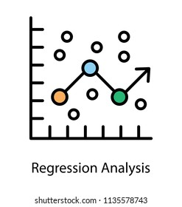
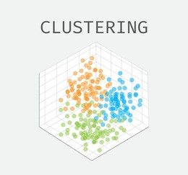
Methodology/Techniques or Algorithms used.
1. Data Analysis using Pandas
2. Data Visualization and Technical Analysis
3. Fundamental analysis using Regression
4. Trade Call Prediction using Classification
5. Clustering for Diversification analysis

Slide 9
Tools Used
Python :
Python programming language to analyze the stock market interactively. Stock Market Analysis means analyzing the current and historical trends in the stock market to make future buying and selling decisions.
2. Sklearn :
Scikit-learn is the most useful library for machine learning in Python. The sklearn library contains a lot of efficient tools for machine learning and statistical modeling including classification, regression, clustering and dimensionality reduction.
3. Pandas :
Pandas is a Python package providing fast, flexible, and it aims to be the fundamental high-level building block for doing practical, real-world data analysis in Python.

Slide 10
4. Matplotlib :
Matplotlib is a cross-platform, data visualization and graphical plotting library for Python and its numerical extension NumPy.
5. Jupyter Notebook :
Jupyter notebook is a very popular and flexible development environment which lets us write and execute python code, display the output and any kind of visualization or plot, etc. in the same document. however, it is always advisable to install Python with Anaconda environment on your system as well.
6. Seaborn :
Seaborn is a library for making statistical graphics in Python. It builds on top of matplotlib and integrates closely with pandas data structures. Seaborn helps you explore and understand your data.
7. Numpy :
NumPy is the package for scientific computing in Python. NumPy arrays eases advanced mathematical and other types of operations on large numbers of data.

Slide 11
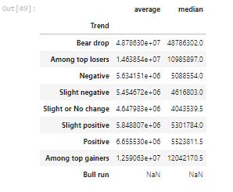
Modules implementation and results.
Module 1 – Pandas (Data Preprocessing – Cleaning and Transformation).
In Module 1, you are going to get familiar with pandas, the python module which is used to process and analyse data. Processing could include removing unknown values from the data or replacing unknown values with values which make sense, maybe 0. Analysing the data could include finding out the trend of a stock price, e.g. how the stock price changes with respect to the Nifty 50 basket of stocks.

Slide 12
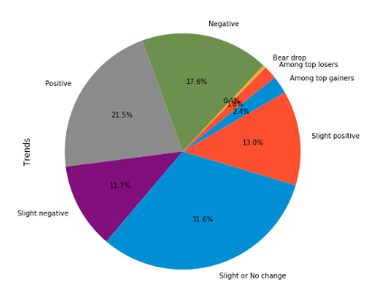
Module 2 – Plotting in Financial Markets (Data Visualization & Technical Analysis).
'A picture speaks a thousand words' has never been truer in financial markets. Absolutely no one goes through the millions of rows of numbers, we always prefer the data in a plotted form to draw better inferences. This module would cover the plotting, basic technical indicators and our own customisation, and making our own trade calls! You should target to finish module 2, including the prerequisites, in 1-2 weeks.

Slide 13
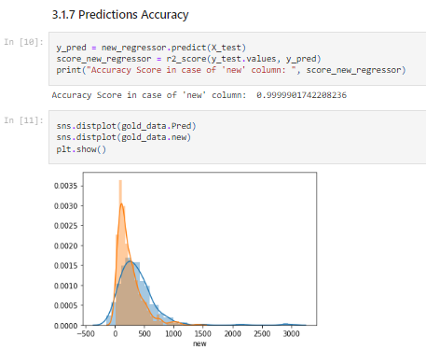
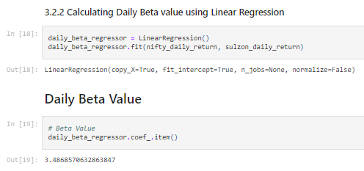
Module 3 – Regression & Beta Calculation.
This module would introduce us to the Regression related inferences to be drawn from the data. Regression is basically a statistical approach to find the relationship between variables. In machine learning, this is used to predict the outcome of an event based on the relationship between variables obtained from the data-set. More often than not, we utilize linear regression to come up with an ideal inference.

Slide 14
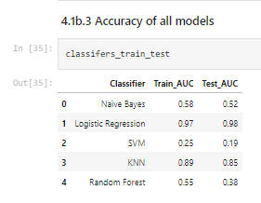
Module 4 – Algorithm Trading using Classifications (Trade Call Prediction)
In this module, we'd be covering the concept of classification and utilize our skills to solve the following queries – (Stock Price = Close Price)
using Bollinger Bands Columns over different classification algorithms models –
Naive bayes (Linear Classifier)
Logistic Regression (Linear Classifier)
Support Vector Machine
K-NEAREST NEIGHBOUR (KNN)
Random Forest
Logistic Regression gives the best accuracy and performance among all five models.
Support Vector Machine Classifier gives worst accuracy and performance.

Slide 15
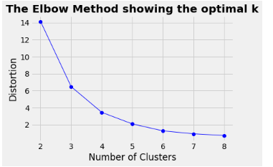
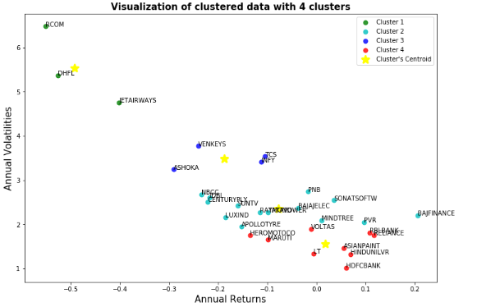
Module 5 – Clustering for Diverse portfolio analysis
Clustering is a method of unsupervised learning and is a common technique for statistical data analysis used in many fields.
Clustering is a Machine Learning technique that involves the grouping of data points. Given a set of data points, we can use a clustering algorithm to classify each data point into a specific group. In theory, data points that are in the same group should have similar properties and/or features, while data points in different groups should have highly dissimilar properties and/or features.
In financial Markets, Cluster analysis is a technique used to group sets of objects that share similar characteristics. It is common in statistics, but investors will use the approach to build a diversified portfolio. Stocks that exhibit high correlations in returns fall into one basket, those slightly less correlated in another, and so on, until each stock is placed into a category.

Slide 16
REFERENCES
[1] Azimifar, M., Araabi, B. N., & Moradi, H. (2020). Forecasting stock market trends using support vector regression and perceptually important points. 2020 10th International Conference on Computer and Knowledge Engineering (ICCKE). doi:10.1109/iccke50421.2020.9303667.
[2] Bhuriya, D., Kaushal, G., Sharma, A., & Singh, U. (2017). Stock market predication using a linear regression. 2017 International Conference of Electronics, Communication and Aerospace Technology (ICECA). doi:10.1109/iceca.2017.8212716.
[3] Fonseca, A. R., Leles, M. C. R., Moreira, M. G., Vale-Cardoso, A. S., Pereira, M. V. L., Sbruzzi, E. F., & Nascimento, C. L. (2021). Testing the Application of Support Vector Machine (SVM) to Technical Trading Rules. 2021 IEEE International Systems Conference (SysCon). doi:10.1109/syscon48628.2021.9447068.
[4] Huang, X. (2020). Research on Strategy of HS300 Index Based on Random Forest. 2020 International Conference on Computing and Data Science (CDS). https://doi.org/10.1109/cds49703.2020.00038.

Slide 17
[5] Kumari, S., Patil, N., Nankar, P., & Kulkarni, M. (2020). CUDA parallel computing framework for stock market prediction using K-means clustering. 2020 International Conference on Smart Electronics and Communication (ICOSEC). doi:10.1109/icosec49089.2020.9215377.
[6] Malawana, M. V. D. H. ., & Rathnayaka, R. M. K. T. (2020). The Public Sentiment analysis within Big data Distributed system for Stock market prediction– A case study on Colombo Stock Exchange. 2020 5th International Conference on Information Technology Research (ICITR). doi:10.1109/icitr51448.2020.9310871.
[7] Mikael Sinaga, F., Sirait, P., & Halim, A. (2020). Optimization of SV-kNNC using Silhouette Coefficient and LMKNN for Stock Price Prediction. 2020 3rd International Seminar on Research of Information Technology and Intelligent Systems (ISRITI). doi:10.1109/isriti51436.2020.9315516.
[8] Panwar, B., Dhuriya, G., Johri, P., Singh Yadav, S., & Gaur, N. (2021). Stock Market Prediction Using Linear Regression and SVM. 2021 International Conference on Advance Computing and Innovative Technologies in Engineering (ICACITE). doi:10.1109/icacite51222.2021.9404733.

Slide 18
[9] Ravikumar, S., & Saraf, P. (2020). Prediction of Stock Prices using Machine Learning (Regression, Classification) Algorithms. 2020 International Conference for Emerging Technology (INCET). doi:10.1109/incet49848.2020.9154061.
[10] Su, C.-Y., Lei, Y., & Wang, M.-X. (2021). Research and Comparison of Random Forests and Neural Networks in Shanghai and Shenzhen Financial 20 Index Prediction. 2021 World Conference on Computing and Communication Technologies (WCCCT). doi:10.1109/wccct52091.2021.00023.
[11] Pingwen Xue, Yuan Lei, Yanxing Li. (2020). Research and prediction of Shanghai-Shenzhen 20 Index Based on the Support Vector Machine Model and Gradient Boosting Regression Tree. 2020 International Conference on Intelligent Computing, Automation and Systems (ICICAS). doi: 10.1109/icicas51530.2020.00019.

Slide 19
Thank You

